Slide 1
Servicemember Beware: How to Spot and Avoid Scams and Fraud
U.S. Coast Guard Wellness Wednesday – Military Consumer Month | July 10, 2024

Slide 2
Disclaimer
This presentation is being made by Consumer Financial Protection Bureau representatives on behalf of the CFPB. It does not constitute legal interpretation, guidance or advice of the CFPB. Any opinions or views stated by the presenters are the presenters’ own and may not represent the CFPB’s views.
This document was used in support of a live discussion. As such, it does not necessarily express the entirety of that discussion nor the relative emphasis of topics therein.

Slide 3
Who We Are and What We Do.
Notes:
So, who are we and what do we do?
Now, I never want to assume that you’re all familiar with the CFPB because some you might be new to your position. And even if you’re not, you might not have firm understanding of our mission. So, I just want to give you a quick overview for context.

Slide 4
CFPB’s Mission and Vision
The Consumer Financial Protection Bureau is a 21st century agency that implements and enforces federal consumer financial laws and military consumer protections, such as the Military Lending Act, and ensures that markets for consumer financial products are fair, transparent, and competitive.
Notes:
The Consumer Financial Protection Bureau (CFPB) is an agency that helps consumer finance markets work by making rules more effective, by consistently and fairly enforcing those rules, and by empowering consumers to take more control over their economic lives.

Slide 5
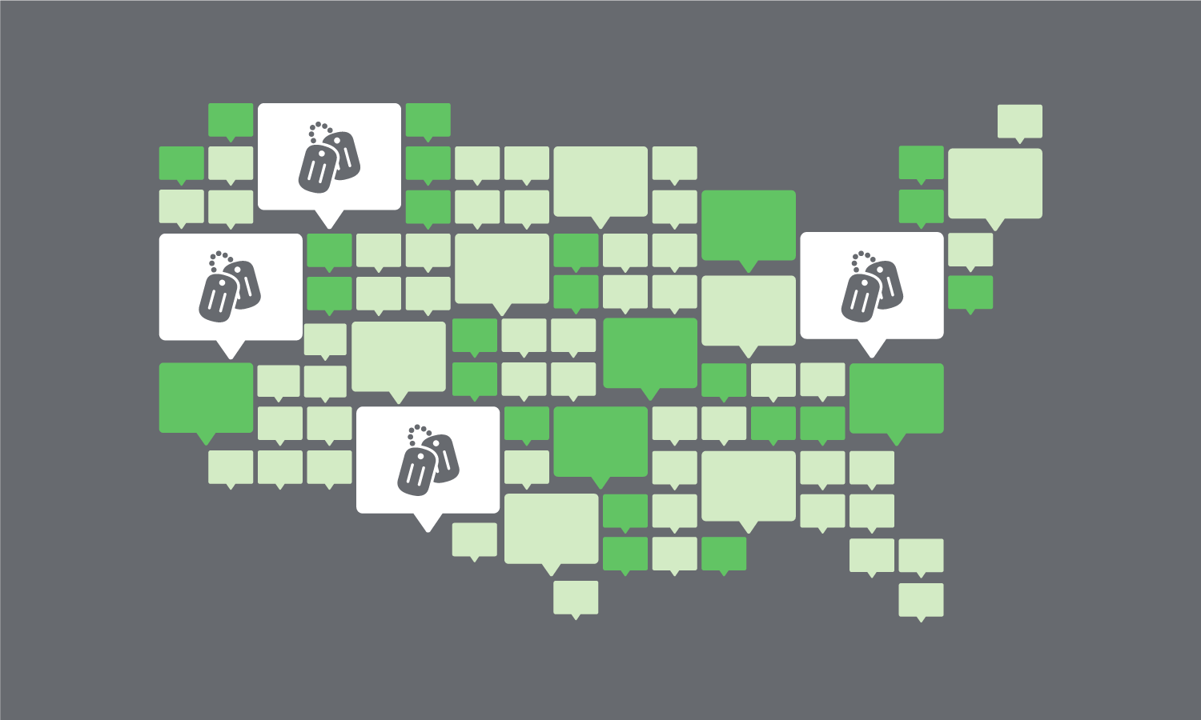
OSA – The Voice of Servicemembers at the Bureau
Notes:
The Office of Servicemember Affairs, or OSA as we’re often called, was established to serve and protect the needs of servicemembers, veterans, and military families in the consumer marketplace. Every servicemember and military family has a unique financial story.
We listen to their issues, we analyze the problems they raise, we implement solutions where we can, and serve as their voice here at the Bureau.

Slide 6
OSA Mission
Educate and empower servicemembers and their families.
Monitor complaints by servicemembers and their families related to consumer financial products.
Coordinate efforts among Federal and State agencies regarding consumer financial products and services offered to, or used by, servicemembers and their families.
Notes:
OSA’s mission has three central mandates under The Dodd-Frank Act that creates the Bureau and the Office:
We educate and empower servicemembers and their families to make better-informed decisions regarding consumer financial products and services they use.
We monitor and analyze consumer complaints submitted by servicemembers and their families; and
We coordinate with other federal and state agencies regarding consumer protection measures for servicemembers, veterans and their families.

Slide 7
OSA Mission (Cont.)
Coordinating with the FTC and the Federal Reserve Board of Governors to ensure that servicemembers and their families are educated and empowered to make better informed decisions regarding consumer financial products and services offered by motor vehicle dealers, with a focus on motor vehicle dealers near military installations.
Notes:
We’re also tasked with coordinating with the FTC and the Federal Reserve Board of Governors to ensure that servicemembers and their families are educated and empowered to make better informed decisions regarding consumer financial products and services offered by car dealers, with a focus on motor vehicle dealerships near military installations.

Slide 8
OSA Collaboration and Coordination
OSA frequently works with other federal and state governments (most notably the DoD, FTC, VA, and DOJ), financial industry groups, military consumer groups, and other educators to improve consumer protection measure for the military community.
Notes:
Now that collaboration take many forms.
As I said, OSA frequently works with other federal and state governments (most notably the DoD, FTC, VA, and DOJ), financial industry groups, military consumer groups, and other educators to improve consumer protection measure for the military community.
This includes:
Coordination with DoD to improve financial education, readiness products, and outreach
Data Sharing with Congress and the public
Having Quarterly meetings to share complaint data with the DOJ and FTC
Sharing complaint data with State Attorneys’ Generals

Slide 9
Financial Marketplace for Servicemembers
Notes:
So, let’s quickly take a look at what in the Financial Marketplace that makes servicemembers and military families vulnerable to scammers.

Slide 10
Unique Financial Challenges
Servicemembers are prime targets for scams and expensive financial products and services.
Servicemembers face proximity risk from businesses operating just outside the gates of installations where they are stationed.
Frequent relocations and permanent change of station orders often means a new home, new utility connections, and other situations where a servicemember or spouse needs to share personal information like Social Security numbers, credit card numbers, and bank account information.
Notes:
Servicemembers are prime targets for scams and expensive financial products and services.
Servicemembers face proximity risk from businesses operating just outside the gates of installations where they are stationed.
Frequent relocation is part of military life, and permanent change of station orders often means a new home, new utility connections, and other situations where a servicemember or spouse needs to share personal information like Social Security numbers, credit card numbers, and bank account information to a wide range of actors, most legitimate, others less so.. Puts them at greater risk for identity theft, scams, and fraud.

Slide 11
Unique Financial Challenges (Cont.)
Data privacy and data brokers are a growing area of concern for servicemembers and military families.
Evasion of military consumer protection laws like Servicemember Civil Relief Act (SCRA) and Military Lending Act (MLA) are also a growing concern.
Harmful business practices can put a servicemember’s career and mission capability at risk.
High indebtedness and shoddy debt collection practices that negatively affect all consumers may have an outsized impact on those serving in uniform
Notes:
Data privacy and data brokers are a growing area of concern for servicemembers and military families.
Evasion of military consumer protection laws like Servicemember Civil Relief Act (SCRA) and Military Lending Act (MLA) are also a growing concern.
Harmful business practices can put a servicemember’s career and mission capability at risk.
High indebtedness and shoddy debt collection practices that negatively affect all consumers may have an outsized impact on those serving in uniform

Slide 12
Fraud and Scams.
Notes:
So, let’s talk scams. Now, scam come in an array of flavors…from classic to artisanal. Scammer are very good at the bad they do. But, in general there usually four (4) signs to look for in you suspect scam or fraud:
Scammers PRETEND to be from an organization you know.
Scammers say there’s a PROBLEM or a PRIZE.
Scammers PRESSURE you to act immediately.
Scammers tell you to PAY in a specific way.

Slide 13
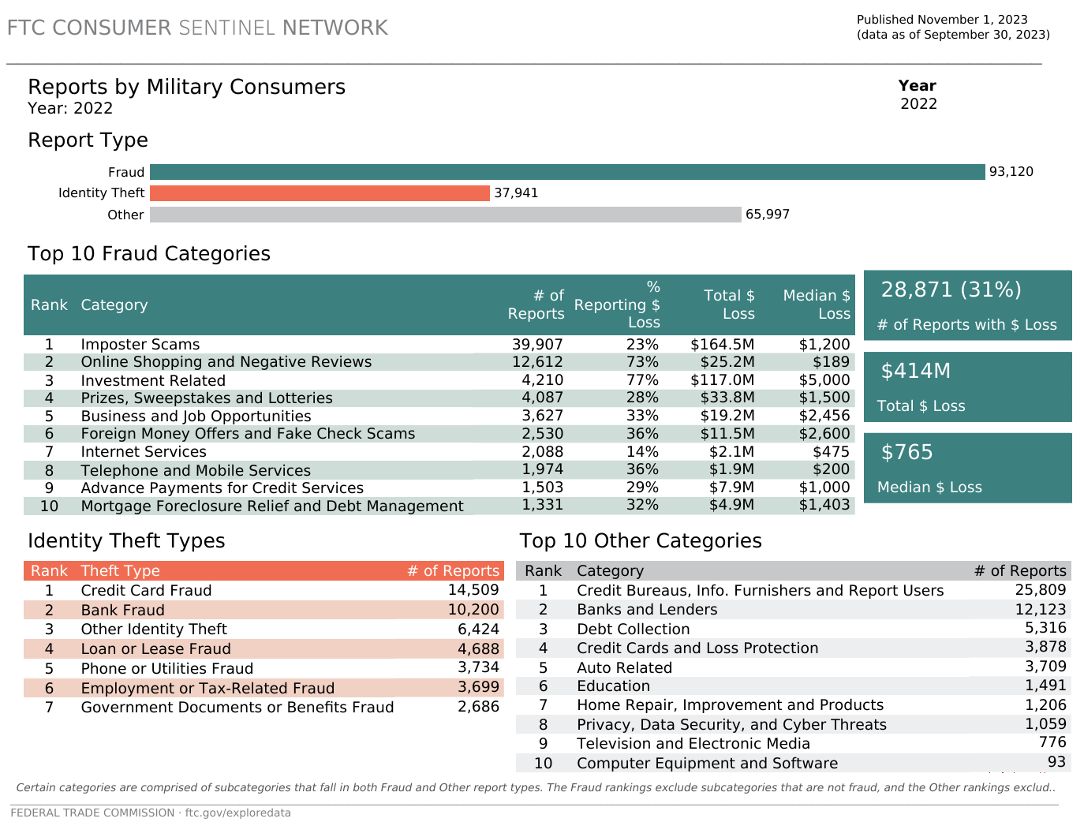
FTC Military Consumer Fraud Report
Notes:
According to the Federal Trade Commission (FTC), military consumer reported almost 29,000 incidents of scams and fraud last year.
They lost an average $765 a person. And, reported a total loss of $414 million dollars in 2022.
You can see the top ten scams reported on your screen now.

Slide 14
Common Types of Fraud and Scams
Cryptocurrency scams
Peer-to-Peer (P2P) and Mobile Payment Scams
Social media takeover
Job scams
Fake check scams
Payday loan scams
Accidental payment scam
Fake invoice scam
consumerfinance.gov/ask-cfpb/what-are-some-common-types-of-scams-en-2092/
Notes:
COMMON SCAMS
Cryptocurrency scams
Scammers may convince people to invest in fake cryptocurrency accounts.
Peer-to-Peer (P2P) and Mobile Payment Scams
Some scammers trick you into sending them money through a mobile payment app because once you do, it’s hard for you to get your money back.
Social Media Takeover
Scammers takes over a person’s real social media account then messages their friends or family members claiming they need money urgently.
Job scams
These include work-from-home scams and fake job listings.
Fake check scams
Scammers send fake checks and ask the recipient to deposit the money and send it elsewhere. If someone sends you a check and asks for money back, it's a scam. Scammers send money on a platform like Venmo, CashApp, or Zelle or via check and then claim that it was sent by mistake and that you need to send the money back. Another version is where they pretend to give you a loan, but you need to pay the fees upfront first.
Payday loan scams
A scammer obtains your personal information, such as bank account and Social Security numbers, under the pretense that they need it to deposit your loan funds into your account.
Accidental payment scam
A scammer sends money to a person’s account then contacts them asking the funds be returned because they were sent by mistake. The fraudster may have sent the money with stolen credit card information. If you send the money back and the actual card owner or bank cancels the original charge, you’ll be the one stuck with a loss.
Fake invoice scam
Scammers create fraudulent invoices with a real company’s branding attached. The invoices come from PayPal.com and include a link to a PayPal page that displays the invoice. If a person is not paying attention, they may pay the fake invoice.

Slide 15
Common Types of Fraud and Scams (Cont.)
One-time password bot scams
Student loan forgiveness scams
Cash flipping
Cash App Promotions
Fake bank alerts
Fake barcodes on gift cards
Package delivery scams
Out-of-stock item scam
consumerfinance.gov/ask-cfpb/what-are-some-common-types-of-scams-en-2092/
Notes:
One-time password bot scams
Scammers use a bot to make a robocall or send a text that appears to come from a bank, asking you to authorize a charge, then it asks you to enter the authentication code you’ve just been sent if the transaction isn’t yours. It’s actually the bot that’s trying to log into your bank account.
Student loan forgiveness scams
Scammers build phony application sites aimed at stealing applicants’ Social Security numbers and bank information, and sometimes they contact targets by phone, pressuring them into applying and charging a fee for their help.
Cash flipping
Cash flipping scams, also known as money circle scams, are a cybercrime version of real-world pyramid schemes. The scheme may promise to double or quadruple your money by investing it in the stock market through a friend or professional contact.
Cash App Friday promotions
Cash App once did a #CashAppFriday promotion that went viral on Twitter and Instagram, where anyone who followed or commented with their $Cashtag was entered in a cash giveaway.
Fake bank alerts
Scammers impersonating your bank may call to alert you about “suspicious activity” on your account and direct you to send money to yourself or “the bank’s address” to reverse a transaction or to verify the account is not frozen.
Fake barcodes on gift cards
​Law enforcement agencies warn that nimble-fingered crooks affix fake barcode stickers over the real ones on the back of gift cards in stores. When you purchase the card, the cashier scans the fake barcode at checkout — directing your money into the scammer’s gift card account.​
Package delivery scams
New package delivery scams include texts and phone calls purportedly from a professional-sounding delivery driver who can’t find your house.
Out-of-stock item scam
Scammers often place fake ads on social media sites for products at too-good-to-be-true prices, take your order and payment info, then tell you the item’s not available right now. Your refund is on the way, they promise, but it never arrives. And you can’t reach anyone at the company about it.​​

Slide 16
Common Types of Fraud and Scams (Cont.)
Puppy purchase scams
Check washing scams
Free-gift QR code scams
Amazon impostor scams
Crypto “recovery” scams
Tech support scams
Rental apartment and home scams
Daycare or childcare scams
consumerfinance.gov/ask-cfpb/what-are-some-common-types-of-scams-en-2092/
Notes:
Puppy purchase scams
Scammers try to exploit dog lovers by offering cute puppies for sale online that don’t exist.
Check washing scams
Check washing scams is where crooks steal checks from mailboxes and bathe them in household chemicals to erase the original name and dollar amount, leaving blank spaces they can fill in. It’s possible to convert a $25 check to one for thousands of dollars.
QR code scams
Scammers send or put fake codes over barcodes or QR codes. The code add malicious code to your phone.
Amazon impostor emails, calls, and texts
Amazon scams are a type of impersonation scam in which fraudsters pose as Amazon representatives and trick you into sharing your personal identifiable information (PII), sending money, or giving up access to your Amazon account.
Crypto “recovery” scams
A crypto recovery scam is a type of advance-fee fraud. Recovery scams target victims who have already been harmed by other frauds. They ask victims to pay upfront for the chance of getting a larger sum of money later.
Tech support scams
A tech support scam is a type of fraud where scammers pose as tech support representatives from well-known companies. They use scare tactics to trick victims into paying for unnecessary services to fix non-existent problems
Rental apartment and home scams
Rental scams are schemes where someone pressures you to sign a lease or give a deposit for a rental that doesn't exist or isn't available
Daycare or childcare scams
Like rental scams just targeted to people needing child care.

Slide 17
Common Types of Fraud and Scams (Cont.)
Refund scams
Robocalls and scam texts
Elder financial exploitation
Foreclosure relief scam
Fraud by fiduciaries
Identity theft
Imposter and Government scams
Mail fraud
consumerfinance.gov/ask-cfpb/what-are-some-common-types-of-scams-en-2092/
Notes:
Refund scams
A type of fraud that involves tricking you into giving money for a product or service that was not purchased, returned, or recalled.
Robocalls and scam texts
No explanation needed there.
Elder financial exploitation
Elder financial exploitation is the illegal or improper use of an older adult’s funds, property, or assets.
Foreclosure relief scam
Foreclosure relief and mortgage loan modification scams are schemes to take your money or your house—often by making a false promise of saving you from foreclosure.
Fraud by fiduciaries
When a fiduciary spends the money for his or her own benefit, that may be fraud.
Identity theft
Identity theft occurs when someone steals your identity to commit fraud.
Imposter and Government scams
Imposter scammers try to convince you to send money by pretending to be someone you know or trust like a sheriff, local, state, or federal government employee, or charity organization
Mail fraud
Mail fraud letters look real but the promises are fake.

Slide 18
Common Types of Fraud and Scams (Cont.)
Phishing, Smishing, and Vishing
Spoofing
Wire or money transfer fraud
Romance Scams
Lottery and Prize Scams
Charity Scams
VA Benefit Scams
Debt Collection and Debt Settlement Scams
Notes:
Phishing
Fraudulent e-mails and websites meant to steal data
Smishing
Fraudulent text messages meant to trick you into revealing data
Vishing
Fraudulent phone calls that induce you to reveal personal information.
Spoofing
Spoofing occurs when a caller disguises the information shown on your caller ID.
Wire or money transfer fraud
Some scammers trick you into wiring or transferring money to steal from you.
Romance Scams
A romance scam is when a new love interest tricks you into falling for them when they really just want your money.
Lottery and Prize Scams
In a lottery or prize scam, the scammers may call or email to tell you that you’ve won a prize through a lottery or sweepstakes and then ask you to pay an upfront payment for fees and taxes.
Charity Scams
A charity scam is when a thief poses as a real charity or makes up the name of a charity that sounds real in order to get money from you.
VA Benefit Scams
Servicemembers are scammed for their benefits by scammers
Debt Collection and Debt Settlement Scams
Scammers who pose as debt collectors to get you to pay for debts you don't owe or ones you’ve already been paid.
And
Debt settlement or relief companies often promise to renegotiate, settle, or in some way change the terms of a person's debt to a creditor or debt collector.

Slide 19
Common Types of Fraud and Scams (Cont.)
Unemployment benefits scams
Errand Helper Scams
Coronavirus Scams
Notes:
Unemployment benefits scams: Scammers are fraudulently filing unemployment claims using stolen personal identity information. According to the FTC, this type of scam rose a whopping 2,920% in 2020
Errand Helper Scams:
Scammers offer help with errands, then run off with the money
Coronavirus Scams
Fake coronavirus-related charities, treatments, test kits, vaccine cards, medical devices, benefits, etc.

Slide 20
Mortgage Fraud and Scams
‘Too good to be true’ interest rates
Credit score/Bad credit doesn’t matter
Excessive loan costs/repayment ability
Income or home value inflation
Good faith loan estimate not produced or honored
Prepayment penalties/Surprise fees
Identity Theft/Spoof Scams
Notes:
In cases of mortgage scams , scammers often promise one of three things, there could be more, but these three are red flags:
‘Too Good To Be True’ Interest Rates
Mortgage rates that are noticeably lower than market interest rates are typically a sign of various hidden fees or even a bait-and-switch tactic. Predatory lenders may try to tell you that you no longer qualify for the advertised rate, or tack on additional fees after locking in the original rate if they think they can get away with it.
Your Credit Score Doesn’t Matter
Your credit score will always affect your mortgage rate, without exception. If you’re being offered a home loan that states this score won’t affect the mortgage, be wary. These tactics are typically schemes that prey on low-income borrowers and generally come with undesirable terms.
Excessive loan costs/Not taking into account your ability to pay
A mortgage payment should remain under 28% of your monthly income.³ The higher your debt-to-income ratio (DTI), the riskier you are for a mortgage lender. If your lender is recommending a type of home that requires a loan larger than 28% of your disposable income, be wary.
Income or home value inflation
Overvalued property creates risk for legitimate mortgage lenders by generating an inaccurate resale valuation or an inflated borrower income that will be difficult to pay off with existing income. Overstating income can out your ability to repay at risk and in some places is a crime.
Your Loan Estimate Isn’t Honored
Within three business days of receiving your mortgage application, a lender must provide a good faith estimate (GFE).8 The GFE provides you with basic information about the loan including estimated costs of the loan. The estimate comes on a standardized form issued by the U.S. Department of Housing and Urban Development (HUD).9 If it comes on any other form, or you don't receive the GFE within three days, don't work with that company.
Under the Real Estate Settlement Procedures Act (RESPA), mortgage lenders are required to honor the Loan Estimate within the relative tolerance level. If these estimates aren’t honored outside of changed circumstances, be wary of predatory lending.
Penalties For Prepayment/Surprise fees
A prepayment penalty is charged for paying off your mortgage too quickly or for refinancing. While prepayment penalties can offer lower overall interest rates, oftentimes, they’re hidden in the fine print of agreements. As a result, many borrowers don’t realize the stipulations of the penalties and are hit down the line with fees. Generally, these penalties are included as a way for lenders to make money on interest payments at the expense of the borrower.
Identity Theft/Spoof Scams
Scammers are increasingly targeting real estate professionals, seeking to compromise their email in order to monitor email correspondences with clients and identify upcoming real estate transactions. During the closing process, scammers send spoofed emails to homebuyers – posing as the real estate agent, settlement agent, legal representative or another trusted individuals – with false instructions for wiring closing funds.

Slide 21
Veterans Benefits Scams
Veterans and spouses, look out for these signs of possible benefit scams:
Offers to file an application to get you benefits or increase your pension for a fee
Claims to get you benefits faster for a fee
Advice to move your money so you’ll qualify for benefits
Notes:
Look out for Veteran Benefits Scams. Especially on things like the GI Bill scams, funerals, pensions and Pact Act Claim Sharks.
Veterans, or surviving spouses who are eligible for a veteran’s pension, may be eligible for the Aid and Attendance benefit. This benefit may be granted if the individual needs help with activities of daily living, is bedridden, is a patient in a nursing home, or has certain vision limitations.
Veterans benefit fees usually always involve:
Offers to file an application to get you benefits or increase your pension for a fee
Claims to get you benefits faster for a fee
Advice to move your money so you’ll qualify for benefits
These types of scammers also often target Social Security benefits as well.

Slide 22
How to Protect Yourself
Shop around to find a legitimate mortgage lender
Questioning any unsolicited loan offers you might receive
Not giving out money upfront to a lender without having a written explanation
Safeguarding your personal information and banking information
Reading the fine print on all loan documents throughout process
Steering clear of lenders who discourage you consulting a certified credit counselor, JAG, or financial professional
Notes:
Here are some of your best defenses.
Shopping around to find a legitimate mortgage lender (you can connect with a HUD-licensed counselor to verify a lender's credentials)
Questioning any unsolicited loan offers you might receive and who is sending them to you (asking questions can be the fastest way to root out a potential scammer)
Not giving out money upfront to a lender without having a written explanation of what the money will cover
Safeguarding your personal information and banking information and questioning any unsolicited requests for either one from someone claiming to be a mortgage lender
Reading the fine print on all loan documents you receive from the time you fill out the application to the time you sit down at the closing table
Steering clear of lenders who discourage you from talking to a certified credit counselor, attorney, or financial professional about the terms of your loan
Questioning any offers that seem too good to be true, which can be a clear indicator that they probably aren't what they seem
Refusing to work with lenders or real estate agents who engage in bullying practices or appear to be trying to pressure you into making a deal
Verifying that everyone involved in the mortgage process, from your lender to the closing attorney, is certified and legitimate

Slide 23
How to Protect Yourself (Cont.)
Questioning any offers that seem too good to be true
Refusing to work with lenders or real estate agents who bully or use pressure tactics
Verify that everyone involved in the mortgage process, from your lender to the closing attorney, is certified and legitimate
Notes:
Here are some of your best defenses.
Questioning any offers that seem too good to be true, which can be a clear indicator that they probably aren't what they seem
Refusing to work with lenders or real estate agents who engage in bullying practices or appear to be trying to pressure you into making a deal
Verifying that everyone involved in the mortgage process, from your lender to the closing attorney, is certified and legitimate

Slide 24
How to Protect Yourself (Cont.)
Don’t share numbers or passwords for accounts, credit cards, or Social Security.
Never pay up front for a promised prize. It’s a scam if you are told that you must pay fees or taxes to receive a prize or other financial windfall.
After hearing a sales pitch, take time to compare prices. Ask for information in writing and read it carefully.
Too good to be true? Ask yourself why someone is trying so hard to give you a “great deal. If it sounds too good to be true, it probably is.
Notes:
Here are some of your best defenses.
Don’t share numbers or passwords for accounts, credit cards, or Social Security.
Never pay up front for a promised prize. It’s a scam if you are told that you must pay fees or taxes to receive a prize or other financial windfall.
After hearing a sales pitch, take time to compare prices. Ask for information in writing and read it carefully.
Too good to be true? Ask yourself why someone is trying so hard to give you a “great deal. If it sounds too good to be true, it probably is.

Slide 25
How to Protect Yourself (Cont.)
Watch out for deals that are only “good today” and that pressure you to act quickly. Walk away from high-pressure sales tactics that don’t allow you time to read a contract or get legal advice before signing. Also, don’t fall for the sales pitch that says you need to pay immediately, for example by wiring the money or sending it by courier.
Put your number on the National Do Not Call Registry. Go to www.donotcall.gov or call (888) 382-1222.
Use Credit Freezes and Credit Alerts
Submit a consumer complaint to the CFPB
Notes:
Watch out for deals that are only “good today” and that pressure you to act quickly. Walk away from high-pressure sales tactics that don’t allow you time to read a contract or get legal advice before signing. Also, don’t fall for the sales pitch that says you need to pay immediately, for example by wiring the money or sending it by courier.
Put your number on the National Do Not Call Registry. Go to www.donotcall.gov or call (888) 382-1222.
Use Credit Freezes and Credit Alerts
Submit a consumer complaint to the CFPB

Slide 26
The Bottom Line
The best defense is to say NO if:
Anyone contacts you asking for your Social Security number, bank account number, credit card information, Medicare ID number, or drivers license number.
Anyone contacts you asking for any other personally identifiable information by phone, in person, by text message, or email.
Someone you don’t know contacts you and requests money through a Peer-to-Peer (P2P) payment app like Venmo or Zelle, through pre-paid gift cards, or cryptocurrency like Bitcoin.
consumerfinance.gov/coronavirus/avoiding-scams
Notes:
Here are some of your best defenses.
Anyone contacts you asking for your Social Security number, bank account number, credit card information, Medicare ID number, or drivers license number.
Anyone contacts you asking for any other personally identifiable information by phone, in person, by text message, or email.
Someone you don’t know contacts you and requests money through a Peer-to-Peer (P2P) payment app like Venmo or Zelle, through pre-paid gift cards, or cryptocurrency like Bitcoin.

Slide 27
Military Lending Act and Servicemembers Civil Relief Act.

Slide 28
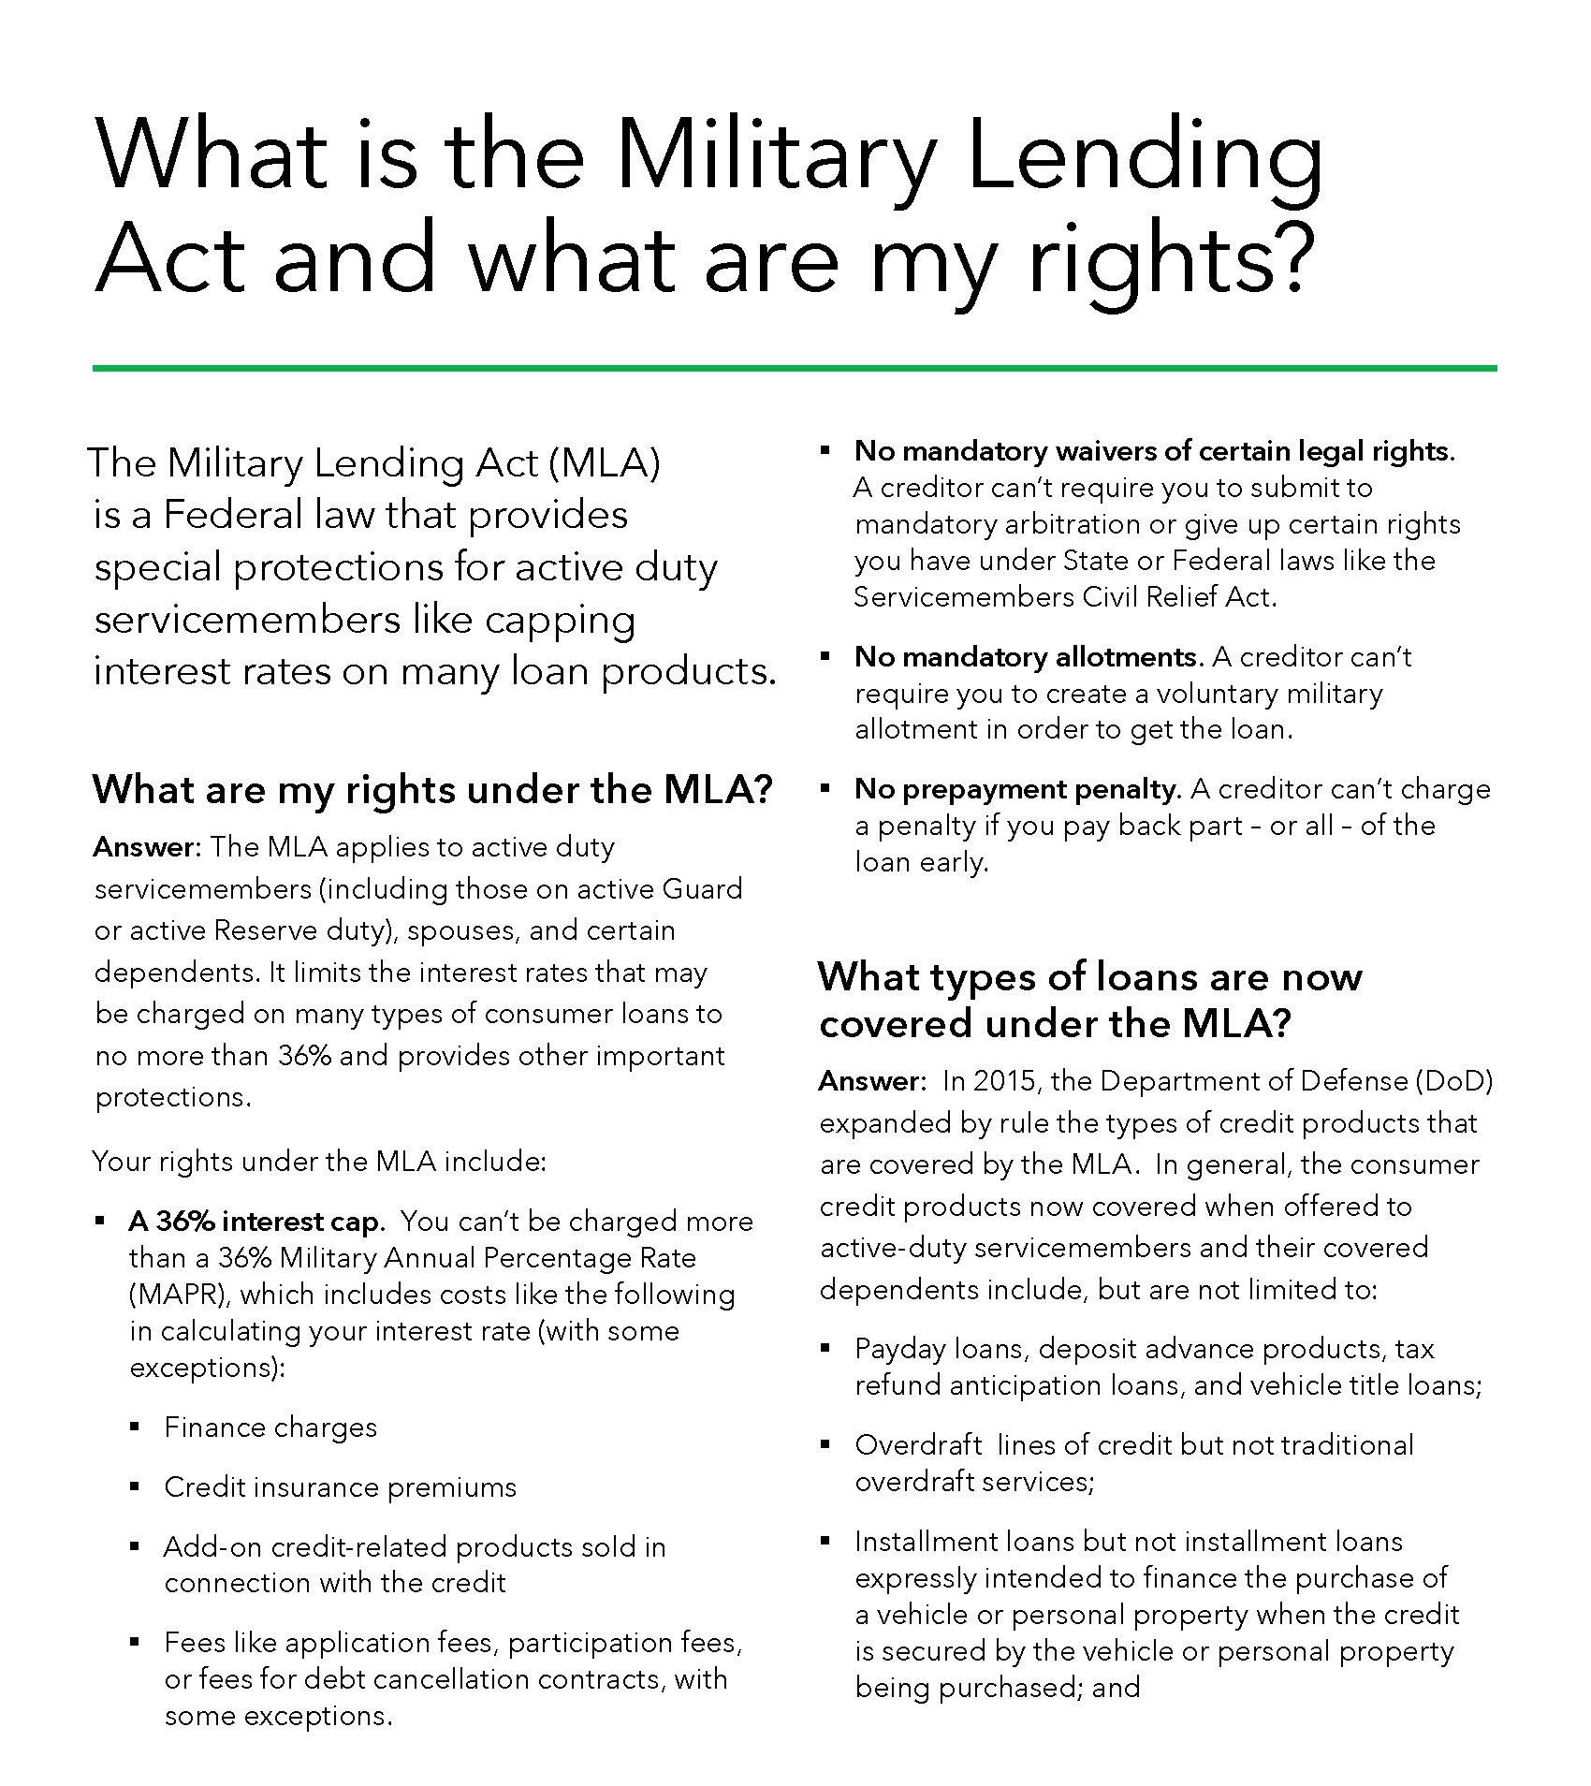
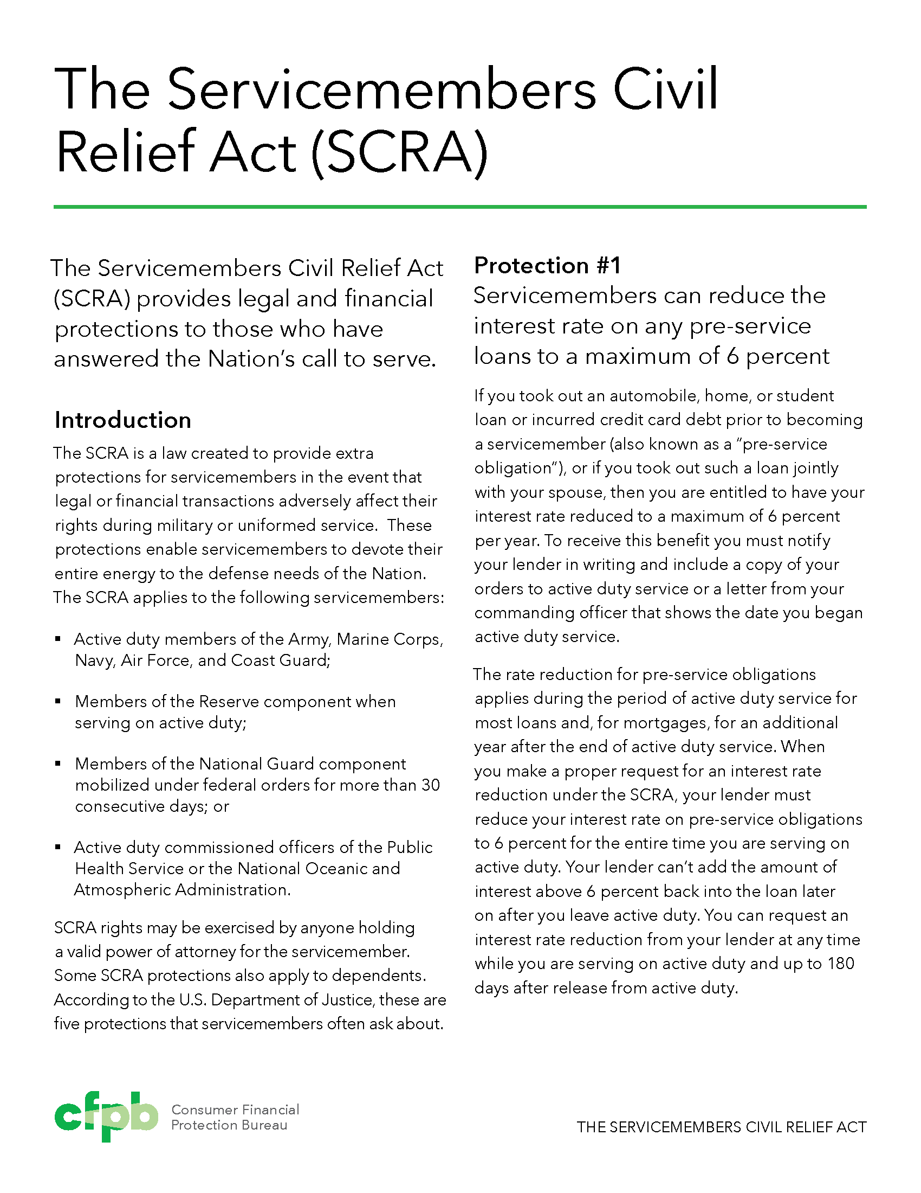
Military Lending Act and Servicemembers Civil Relief Act
www.consumerfinance.gov/consumer-tools/military-financial-lifecycle/
Notes:
Let’s talk a little bit about the MLA and SCRA
The MLA and SCRA are two of the most important laws that protect military consumers.
Now you all know what these laws are, but we want you to really key in on some of the key provisions:
SCRA
Allows servicemembers to cap the interest rate on pre-service loans at 6 percent.
Allows servicemembers to terminate contracts like vehicle leases, cell phone contracts, and residential leases under certain conditions without having to pay early termination charges or other penalties. Servicemembers can do that now be email or electronic communications now when the provide copies of their orders when requesting those contract terminations. An important change since January of this year.
Provides some protections against default legal judgments and other actions like repossession, foreclosure, and eviction without a court order.
It is illegal to deny servicemembers their SCRA rights or retaliate against them for asserting them.
MLA
Caps the interest rate and most fees for many types of loans at 36 percent
Lenders can’t require servicemembers to create military allotments to get a loan
Creditors can’t force servicemembers into mandatory arbitration or make them waive their legal rights, including rights under the Servicemembers Civil Relief Act. This is an issue we’ve been concerned about.
Lenders can’t prohibit prepayment or charge servicemembers a pre-payment penalty
The Bureau is paying attention to the MLA. We just released an Interpretive Rule that explains our authority to supervise the MLA.
As Andy mentioned, last December, we sued an online lender for alleged violations of the MLA.
The Bureau alleged that the lender:
Made over 4,000 installment loans to more than 1,200 borrowers covered by the MLA.
The violations included extending loans that exceeded the MLA’s 36% cap
Extending loans that require borrowers to submit to arbitration
And also failing to make certain required loan disclosures, including a statement about how the Military Annual Percentage Rate applies.

Slide 29
MLA Vs. SCRA
The MLA is different from the SCRA in that it applies to certain loans after a servicemember is on active duty.
The MLA limits the interest rate and fees creditors can charge covered borrowers to 36 percent. This is called the Military Annual Percentage Rate or MAPR.
Notes:
For MLA, the key isn’t military status for the protections, it’s who’s a covered borrower
Who is covered under the MLA:
Servicemembers (Active, or Guard and Reserve on active duty on orders longer than 30 days)
A Service member’s spouse;
A Service member’s child who is under the age of 21 or meets certain other conditions;
A Service member’s parent or parent-in-law residing in the Service member’s household who is (or was, at the time of the Service member’s death, if applicable) dependent on the Service member for more than one-half his or her support; and
An unmarried person who over whom the Service member has custody by court order and who meets certain other conditions.

Slide 30
Other Consumer Protection Laws
In addition to SCRA and MLA there are other laws to keep in mind. Servicemembers have the same rights as civilian counterparts.
There is the
FDCPA: Fair Debt Collection Practices Act
FCRA: Fair Credit Reporting Act
Local and state laws
https://www.consumerfinance.gov/about-us/blog/alphabet-soup-abcs-military-consumer-protection/
Notes:
In addition to SCRA and MLA there are other laws to keep in mind. Servicemembers have the same rights as civilian counterparts.
There is the
FDCPA: Fair Debt Collection Practices Act
What it is: The Fair Debt Collection Practices Act (FDCPA) is the main federal law that specifies what debt collectors can and cannot do when collecting certain types of debt.
What it does: The law prohibits debt collectors from using abusive, deceptive or unfair debt collection practices.
Examples of some protections:
Generally, debt collectors aren’t allowed to contact people at a time or place known to be unusual or inconvenient. They also cannot contact you before 8 a.m. or after 9 p.m.
Debt collectors can’t tell others, including a commanding officer or supervisor, about a debt
A debt collector must provide you with certain information about the debt if you request it in writing
FCRA: Fair Credit Reporting Act
What it is: The Fair Credit Reporting Act (FCRA) is a federal law that requires credit reporting agencies to ensure the credit history data they manage is fair, accurate, and protects consumer privacy.
What it does: The law protects a person’s right to access their credit report and have credit history information kept accurate and confidential.
Examples of some protections:
Gives consumers the right to get a free copy of their credit report once a year from each of the three major credit reporting agencies.
Requires credit reporting agencies to examine, verify, or remove disputed credit report information in a timely manner, usually 30 days
Gives consumers the right to receive notice of negative information added to their credit file
The FCRA gives servicemembers the right to place free “Active Duty Alerts” on their credit profile to help prevent against identity theft while they are deployed.
Local and state laws

Slide 31
Consumer Complaints.
Notes:
Consumer Complaints is part of the lifeblood of what OSA does.
The CFPB releases a report annually on the consumer complaints we receive from Servicemembers, veterans, and military family members. We just released our latest annual report last month. So, let’s talk about some of it’s key finding.
Available at: https://www.consumerfinance.gov/data-research/research-reports/office-of-servicemember-affairs-annual-report-fy-2021/

Slide 32
Overview of Servicemember Complaints
Since the Consumer Financial Protection Bureau (CFPB) began accepting consumer complaints in July 2011, servicemembers, veterans, and their families have submitted more than 323,000 complaints.
In 2022 alone, over 66,400 servicemember complaints were submitted a 55% increase compared to 2021, and a 62% increase compared to 2020. The most common types of complaints were Credit or Consumer Reporting and Debt Collection, which in total accounted for more than 54% of servicemember complaints.
Notes:
Since the Consumer Financial Protection Bureau (CFPB) began accepting consumer complaints in July 2011, servicemembers, veterans, and their families have submitted more than 323,000 complaints.
In 2022 alone, over 66,400 servicemember complaints were submitted a 55% increase compared to 2021, and a 62% increase compared to 2020.
The most common types of complaints were Credit or Consumer Reporting and Debt Collection, which in total accounted for more than 54% of servicemember complaints.

Slide 33
Servicemember P2P Issues
Servicemember report fraud, scams, and theft from using peer-to-peer payment apps and money transfers at a rate 50% higher than the general population
Companies that own the peer-to-peer payment systems fail to provide adequate resolutions to servicemembers
Once a servicemember's identity is stolen and reported, they may experience unexpected consequences, such as having their funds withheld or accounts closed or suspended without prior notice
Notes:
Servicemember report fraud, scams, and theft from using peer-to-peer payment apps and money transfers at a rate 50% higher than the general population
Companies that own the peer-to-peer payment systems fail to provide adequate resolutions to servicemembers
Once a servicemember's identity is stolen and reported, they may experience unexpected consequences, such as having their funds withheld or accounts closed or suspended without prior notice

Slide 34
Resources We Offer.
Notes:
Financial education is a big part of what we do and have several resources created specifically for servicemembers and military families.

Slide 35
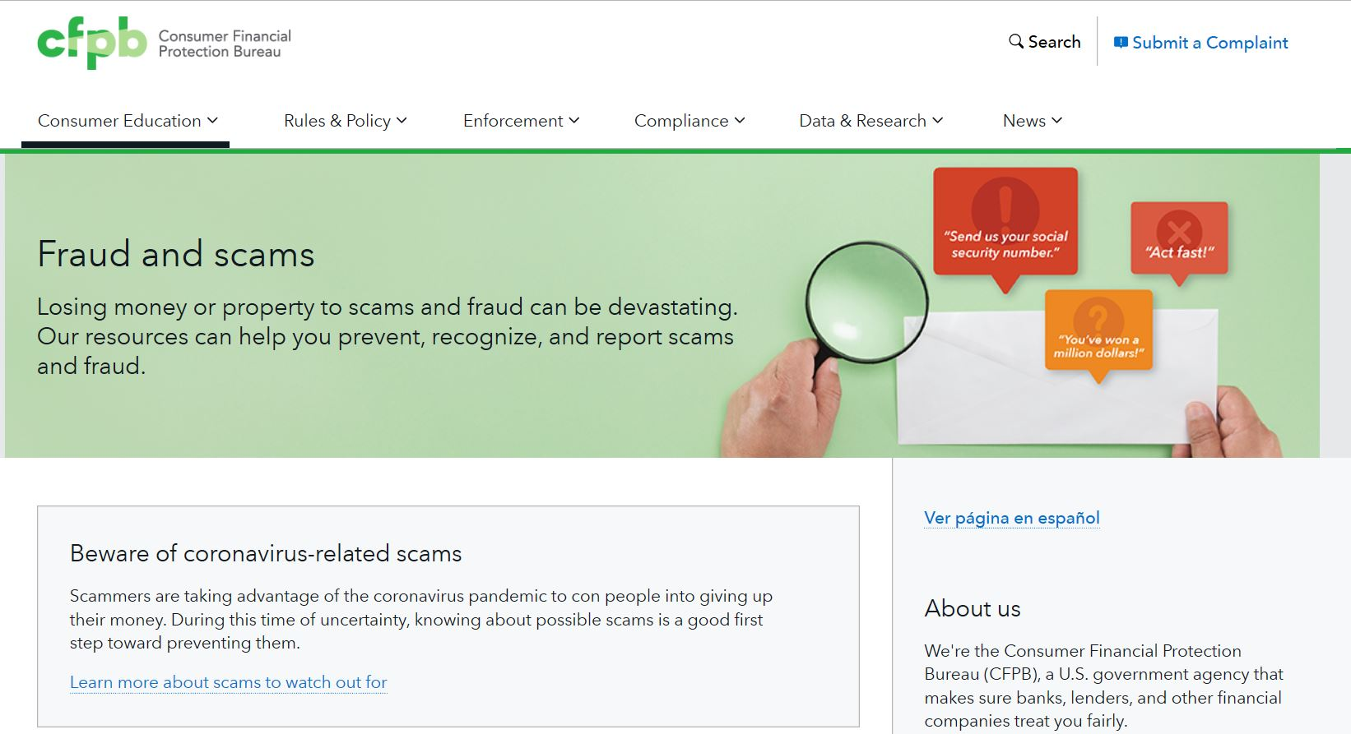
Fraud and Scams Resources
consumerfinance.gov/consumer-tools/fraud
Notes:
Scammers are constantly finding new ways to steal your money. You can protect yourself by knowing what to look out for. We have an entire webpage with resources that can help you do that.
Information on:
Debt collection scams
Debt settlement and debt relief scams
Foreclosure relief scams
Grandparent scam
Imposter scams
Mail fraud
Mortgage closing scams
Lottery or prize scams
Wire or money transfer fraud
National Association of Attorneys General

Slide 36
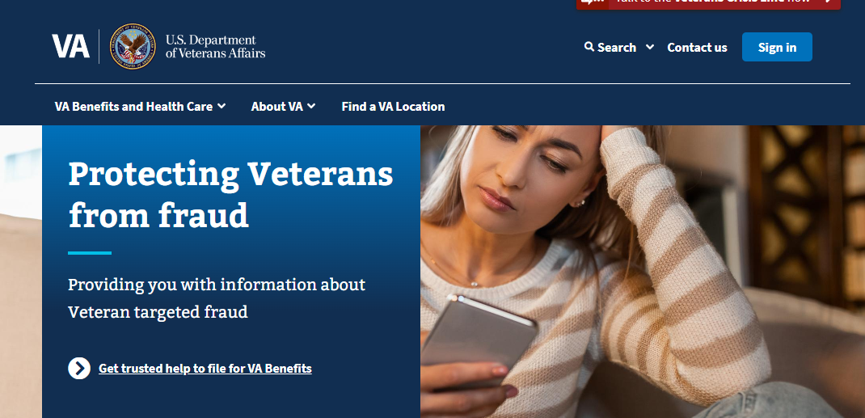
Fraud and Scams Resources (cont’d)
https://www.va.gov/initiatives/protecting-veterans-from-fraud/
Notes:
The VA in partnership with other Federal agencies including the CFPB has launched the VSAFE campaign and task force to combat fraud and scams perpetrated against veterans, service members, and their families.
In the coming months, the VSAFE Task Force will:
Release a Fraud Prevention Tool Kit: VA will partner with Veteran Service Organizations and Military Service Organizations to disseminate a toolkit that provides tips on preventing fraud and scams involving imposters, health care, finances, housing, employment, education, and memorialization.
Publish a Series of Public Service Announcements: To destigmatize conversations about fraud among veterans, VA will publish videos unpacking different forms of fraud.
Create a One-Stop Shop: A whole-of-government effort to consolidate and centralize educational resources and reporting tools, giving veterans no wrong door to access essential federal resources to prevent and report fraud. The Federal Trade Commission (FTC) will take a first step by serving as the central recipient of reports of scams against veterans and Service members at ReportFraud.ftc.gov. These reports will be shared across federal and state agencies using the FTC’s Consumer Sentinel Network, which connects nearly 3,000 federal, state, local, and international law enforcement users. Further, veterans, along with Service members and their families, can keep in touch sign up for email updates from MilitaryConsumer.gov, a centralized source of information on how to spot, avoid, and report scams affecting military related consumers.
Prevent Scam Callers from Targeting Veterans: Recent actions by the Federal Communications Commission (FCC) to block active robocalling scams have already resulted in a 99% drop in auto warranty robocalls and an 88% drop in student loan scam robocalls. The FCC will build upon these efforts by working to identify the originators of scam calls targeting veterans and Service members to enable it to order phone companies to block these calls.
Conduct a Nationwide Listening Tour: VA will hold 10 listening sessions with veterans in populations that are highly targeted by predatory actors to gather veteran feedback on fraud types they’ve experienced, their experiences with reporting fraud, what kind of support they need, among other key areas.
Solicit Feedback on the Car-Buying Experience: The FTC will issue a call for feedback from Service members on their car buying experiences. The FTC has already identified the heightened risks for fraud that car buyers face. This targeted call for feedback will aid the FTC’s ongoing efforts to reduce car buying scams that take advantage of the unique challenges experienced by veterans.
Increase Accessibility of Resources: The FTC will highlight new resource for non-English-speaking Service members and veterans, making it easier for them to access the help that they need.
Expand oversight to help address scams: The Consumer Financial Protection Bureau (CFPB) has conducted extensive engagement with military and veteran service organizations and recently took action to address increasing reports of military identity theft. Earlier this week, the CFPB proposed to extend its oversight to larger nonbank companies that offer services like digital wallets and payments apps, which the CFPB previously found to pose a risk to Service members. The CFPB will advance these initiatives and incorporate feedback from the VA’s nationwide listening tour and the FTC’s call for car-buying feedback into its ongoing work to protect Service members, veterans, and their families.

Slide 37
Fraud and Scams Resources (cont’d)
Other federal resources
Scams and how to recognize them from the Federal Trade Commission Information to help consumers learn about scams and file a complaint. Sign up for FTC “Scam Alerts.”
Investor scams from the Securities and Exchange Commission Alerts and information about COVID-19 investor scams.
Rumor control from Federal Emergency Management Agency Information to help the public distinguish between rumors and facts regarding the response to COVID-19 pandemic.
Notes:
Other federal resources
Scams and how to recognize them from the Federal Trade Commission Information to help consumers learn about scams and file a complaint. Sign up for FTC “Scam Alerts.”
Investor scams from the Securities and Exchange Commission Alerts and information about COVID-19 investor scams.
Rumor control from Federal Emergency Management Agency Information to help the public distinguish between rumors and facts regarding the response to COVID-19 pandemic.

Slide 38
Fraud and Scams Resources (cont’d)
Other Local resources
National Association of Attorneys General
Local consumer protection offices
Local law enforcement
Notes:
Other Local resources
National Association of Attorneys General
Local consumer protection offices
Local law enforcement

Slide 39
Resources are Available in Seven Languages
Spanish, Traditional Chinese, Vietnamese, Korean, Tagalog, and Arabic language materials are available online.
Include:
Housing portal pages
Spanish language videos are also available online:
Aplazamientos de hipotecas en la Ley CARES
5 Pasos para que solicite un aplazamiento de hipoteca por causa del coronavirus
Tres pasos que inquilinos en problemas pueden tomar para retrasar el desalojo
Notes:
Resources are available in seven languages:
Spanish, Traditional Chinese, Vietnamese, Korean, Tagalog, Arabic, and English

Slide 40
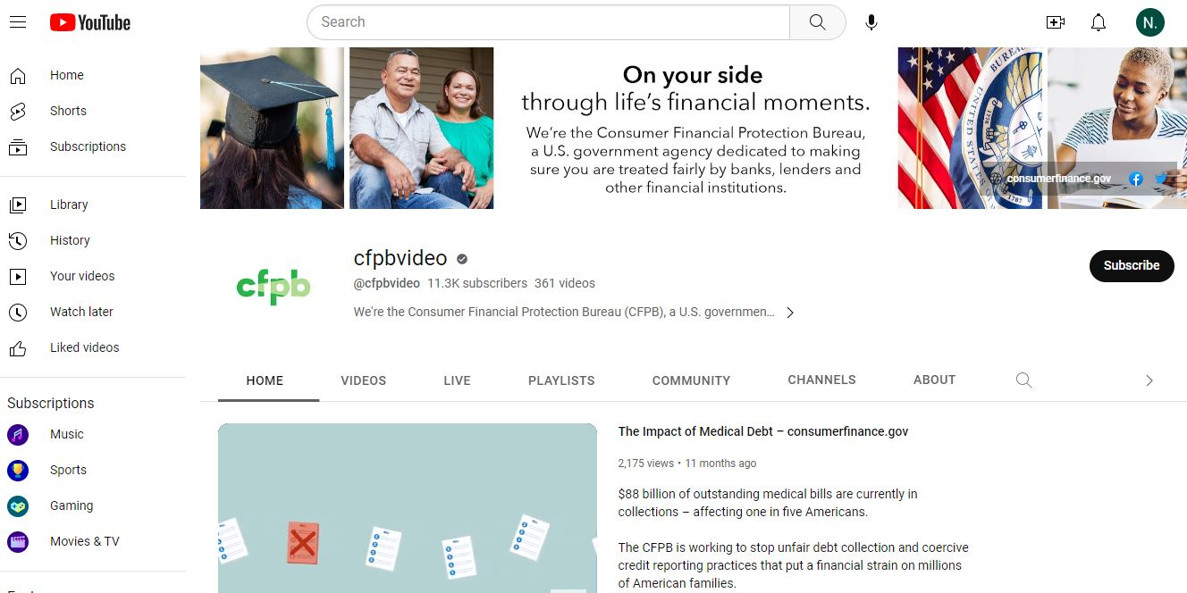
CFPB Social Media Resources
https://www.youtube.com/user/cfpbvideo
https://www.facebook.com/CFPB
https://twitter.com/CFPB
Notes:
No matter what their level of experience, servicemembers and military families are making important financial decisions like buying homes and cars, using credit, and paying for college and everyday purchases. We have consumer tools and online educational resources that can help them improve their money management skills, understand financial products, plan for big financial goals, navigate purchases, and make more informed decisions about your everyday money choices.
The tools were created to help consumers with:
Buying a house
Paying for college
Getting an auto loan
Preparing for disasters and emergencies
Helping children learn about money
Planning for retirement
and more
Servicemembers can also browse a database of questions by money topics to find answers to commonly-asked financial questions with our Ask CFPB tool. They can learn the basics, understand key terms, and find ways to take action when you have an issue with:
Auto loans
Bank accounts and services
Credit cards
Credit reports and scores
Debt collection
Fraud and scams
Money transfers
Mortgages
Payday loans
Prepaid cards
Reverse mortgages
Savings
Student loans
and more

Slide 41
Submitting Consumer Complaints.

Slide 42
Complaint process
Complaint submitted
We accept complaints via the Bureau’s website, telephone, mail, email, fax, and referral.
Review and route
We route complaints to the company for response.
Company response
Company reviews the complaint and reports back about the steps taken.
Complaint published
We publish complaint information and – with consumers’ permission and after removing personal information – the description of what happened.
Consumer review
Consumer reviews the company response and can give feedback about the complaint process.
We route most complaints in less than 1 day.
Companies have 15 days to provide an initial response and up to 60 days to provide a final response, if needed.
Published within 60 days or when the company responds, whichever first.
Consumers have 60 days to provide feedback.
Communication
Consumers who submit online receive an email acknowledging receipt of their complaint. All others receive communications by postal mail.
Communication
We inform the consumer when their complaint has been routed to the company for a response.
Communication
We inform the consumer when the company has responded to their complaint.
Communication
We send consumers a reminder email if they have not logged into the portal to review the company response.
Notes:
When you submit a complaint to the CFPB, your complaint goes through several steps that help you get a response about your issue and help us identify problems in the marketplace. (Link - https://www.consumerfinance.gov/complaint/)
1. Complaint submitted
You submit a complaint about an issue you have with a company about a consumer financial product or service, or another government agency forwards your complaint to us. You will receive email updates and can log in to track the status of your complaint. (Link - https://portal.consumerfinance.gov/consumer/s/)
2. Review and route
We'll forward your complaint and any documents you provide to the company and work to get a response from them. If we find that another government agency would be better able to assist, we will forward your complaint to them and let you know.
3. Company response
The company reviews your complaint, communicates with you as needed, and reports back about the steps taken or that will be taken on the issue you identify in your complaint. Companies generally respond in 15 days. In some cases, the company will let you know their response is in progress and provide a final response in 60 days.
4. Complaint published
We publish information about your complaint—such as the subject and date of the complaint—on our public Consumer Complaint Database. With your consent we also publish your description of what happened, after taking steps to remove personal information. (Link - https://www.consumerfinance.gov/data-research/consumer-complaints/)
5. Consumer review
We will let you know when the company responds. You’ll be able to review the company’s response and will have 60 days to provide feedback about the company's response.
We turn your complaint into action
Complaints help with our work to supervise companies, enforce federal consumer financial laws, and write better rules and regulations. Learn more about how we use complaint data or explore the data on your own in the Consumer Complaint Database. (Link - https://www.consumerfinance.gov/complaint/data-use/)

Slide 43
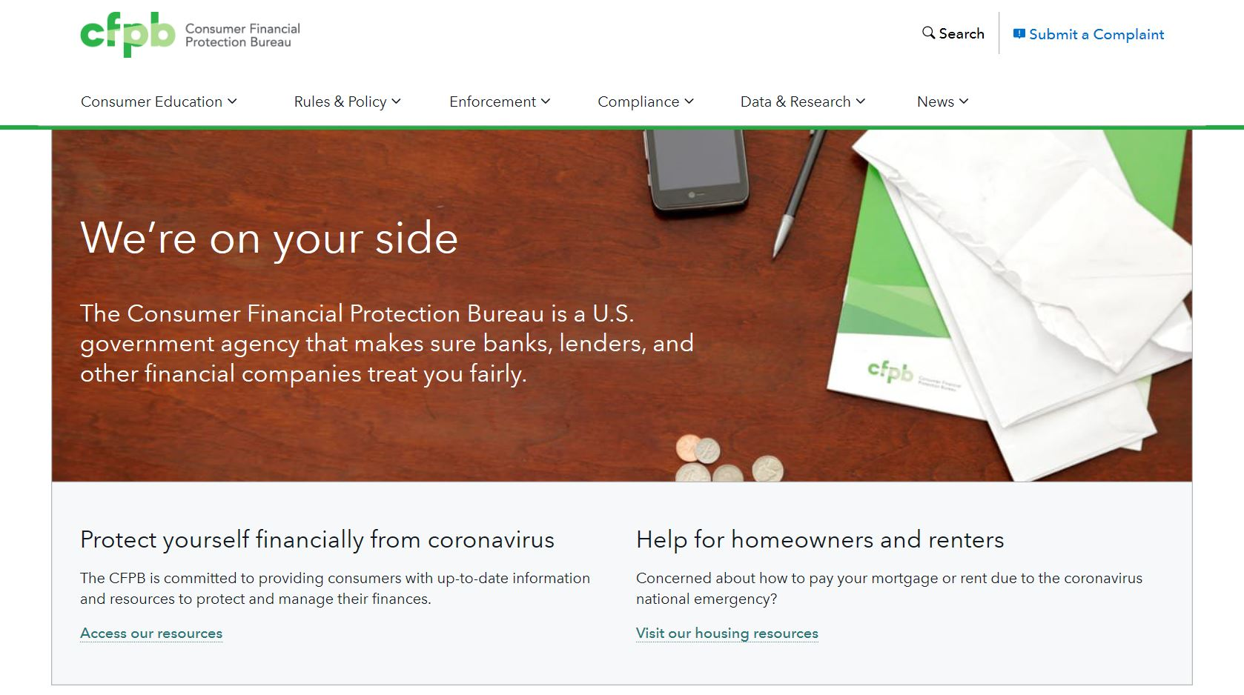
How to Submit a Complaint
consumerfinance.gov/complaint/
Notes:
Submitting a consumer complaint can be an incredibly helpful and effective tool for servicemembers who have a problem with a financial product or service that they can’t resolve on their own.
We take complaints in several different categories including:
Debt collection
Credit reporting, credit repair services, or other personal consumer reports
Mortgage
Credit card or prepaid card
Checking or savings account
Vehicle loan or lease
Student loan
Payday loan, title loan, or personal loan (installment loan or personal line of credit)
Money transfer, virtual currency, or money service (check cashing service, currency exchange, cashier’s/traveler’s check, debt settlement)
A servicemember can submit a complaint by mail, by phone or online. Online is the fastest and most efficient method.
You can also file a referral complaint for them on their behalf.
You’ll need the dates, amounts, and other details about the complaint. If you have documents you want to include, such as billing statements or letters from the company. You’ll be able to attach them.
Make sure to include all the information you can, because you generally can’t submit a second complaint about the same problem.
We’ll forward your complaint and any documents you provide to the company and work to get you a response – generally within 15 days.
How to file a referral consumer complaint.

Slide 44
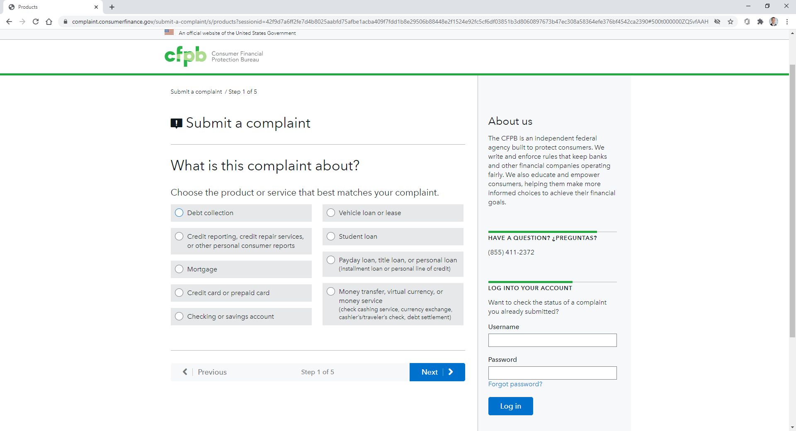
How to Submit a Complaint – Step 1

Slide 45
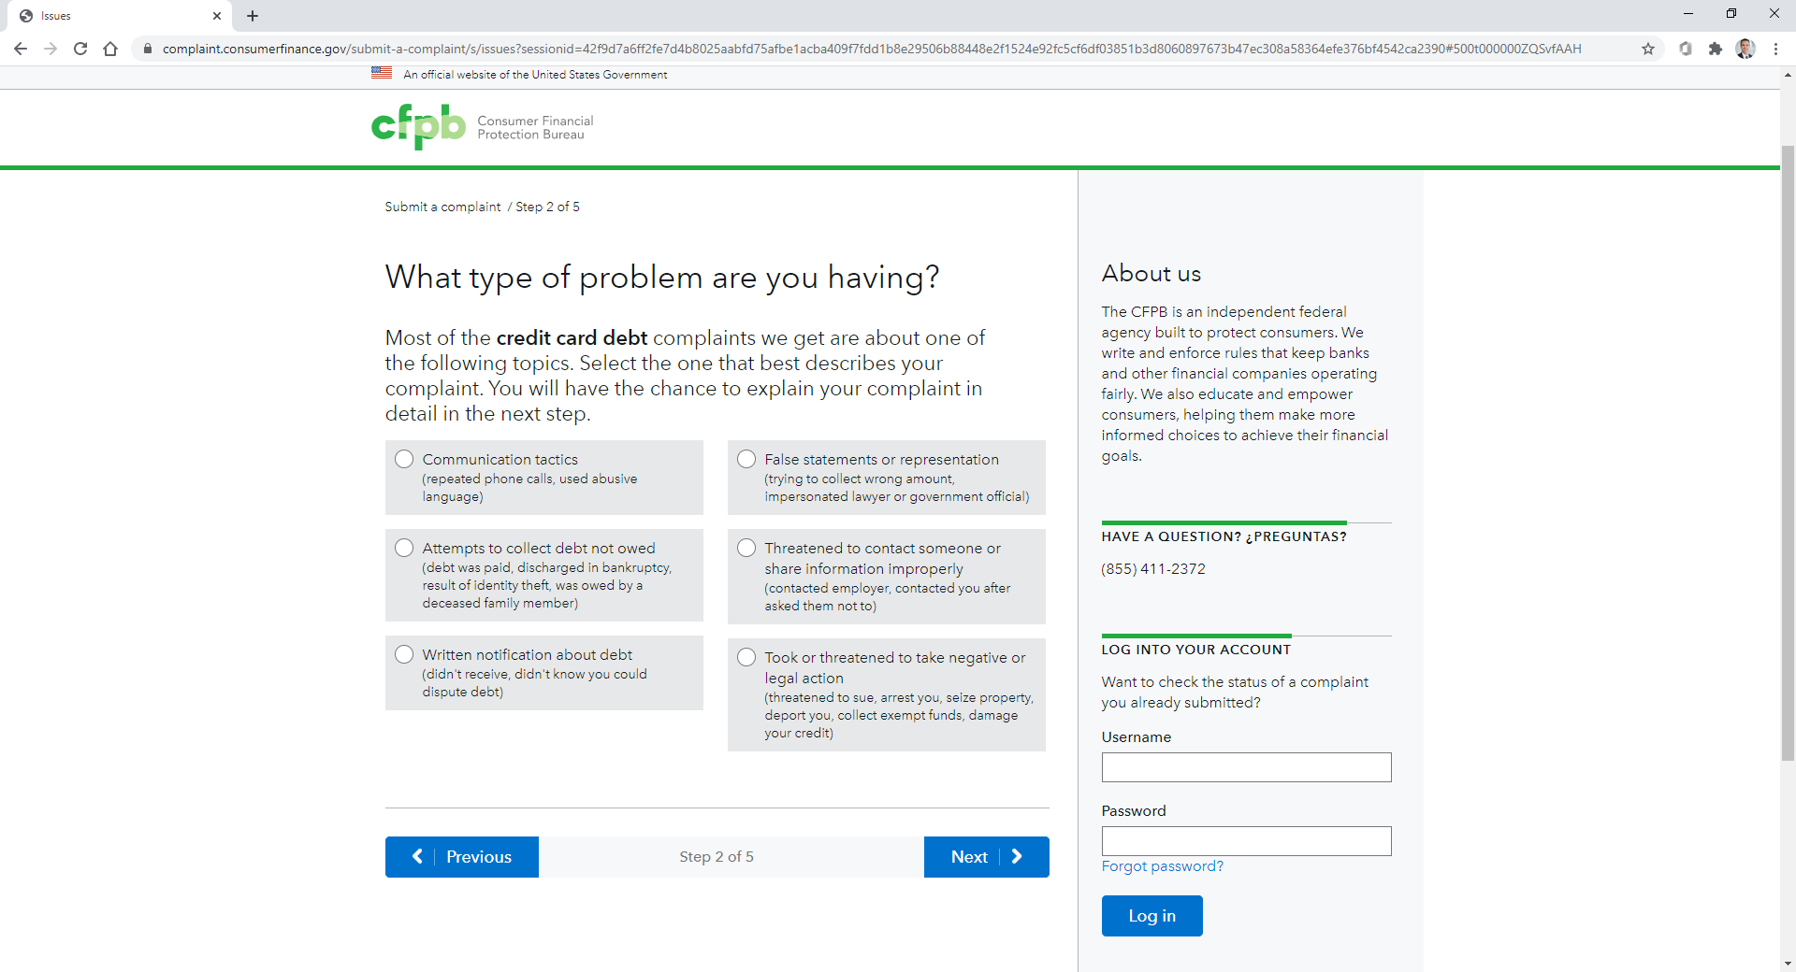
How to Submit a Complaint – Step 2

Slide 46
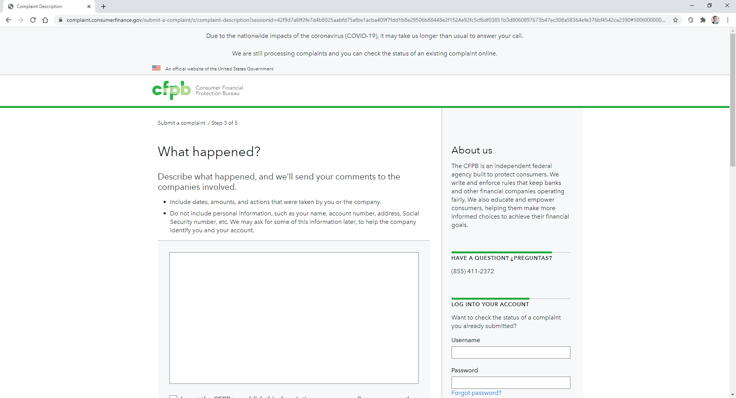
How to Submit a Complaint – Step 3

Slide 47
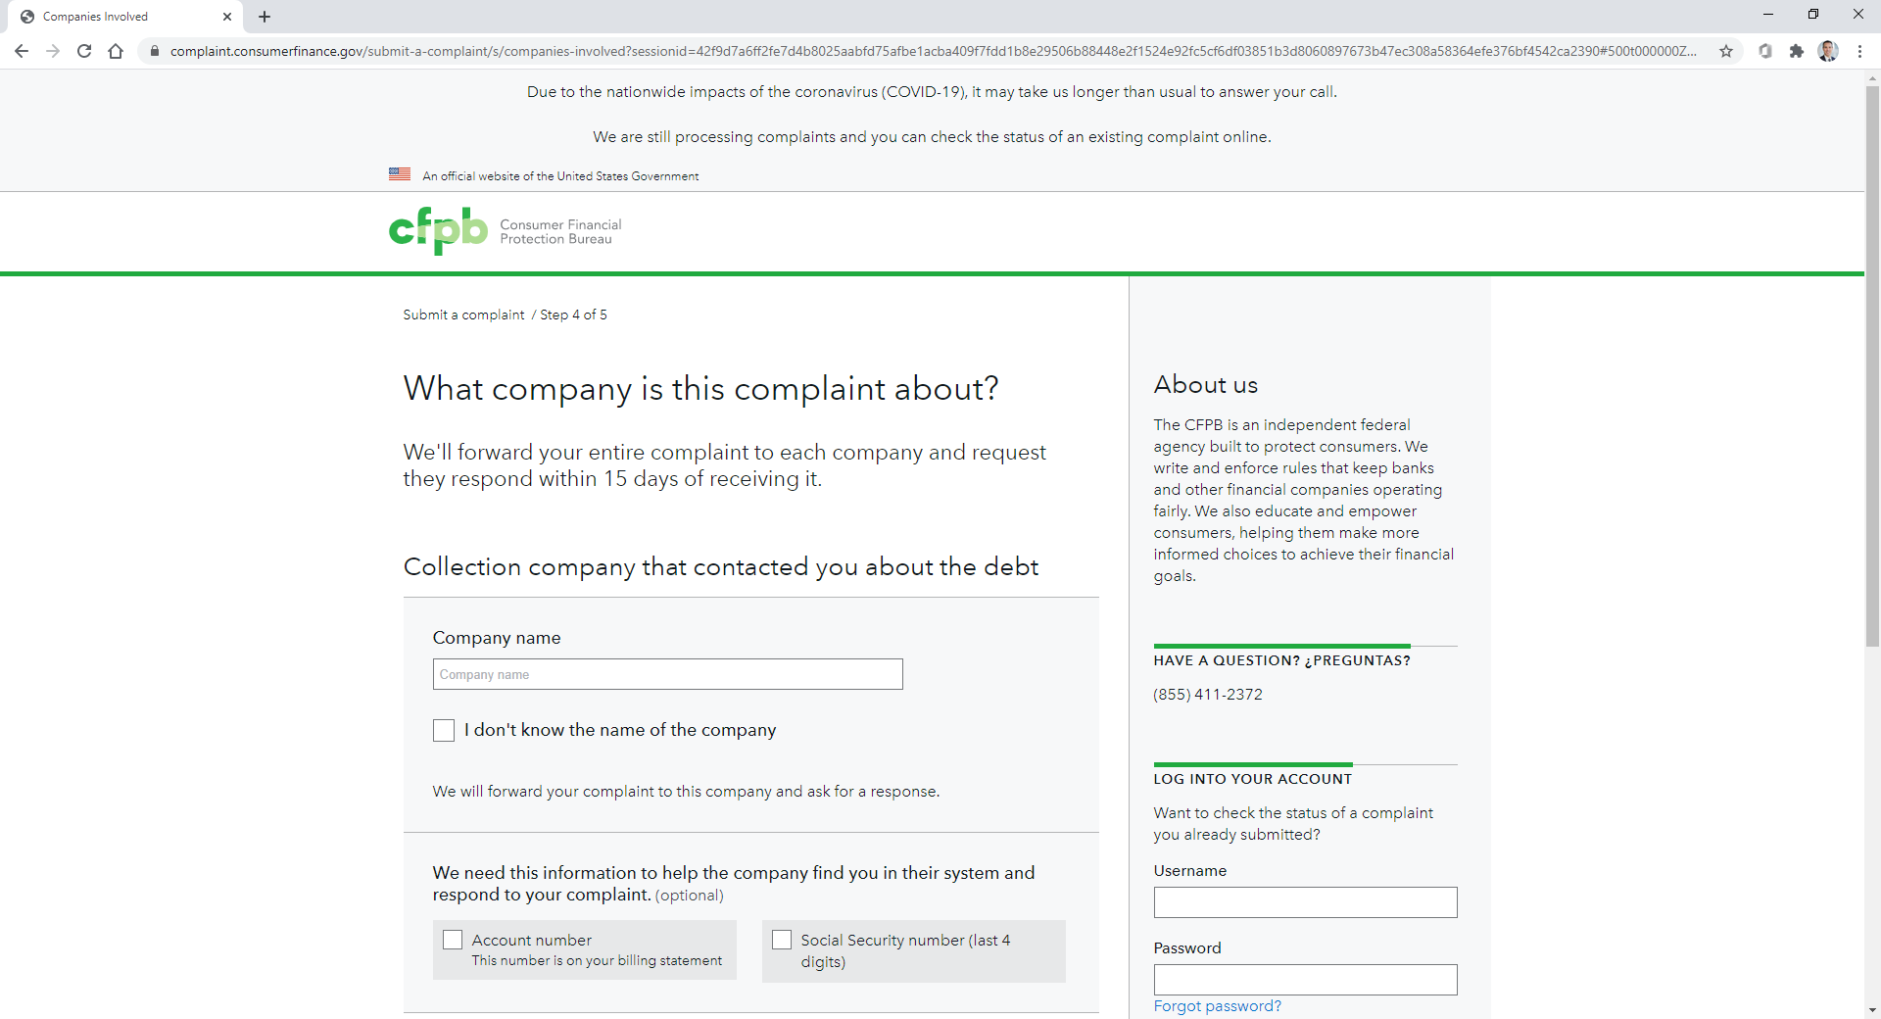
How to Submit a Complaint – Step 4

Slide 48
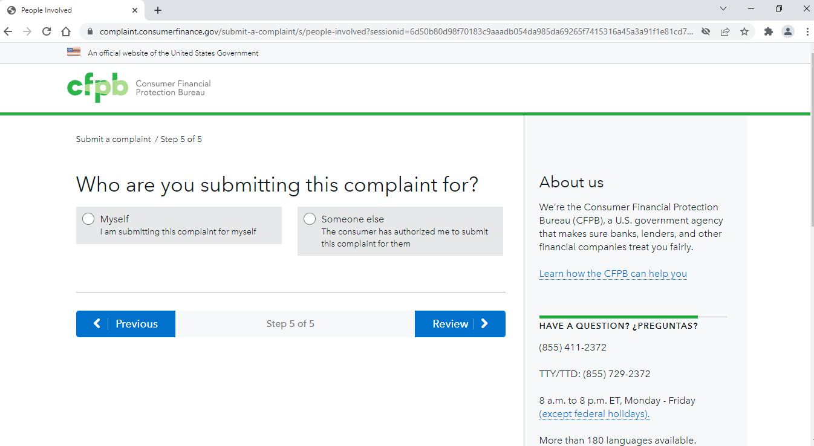
How to Submit a Complaint – Step 5

Slide 49
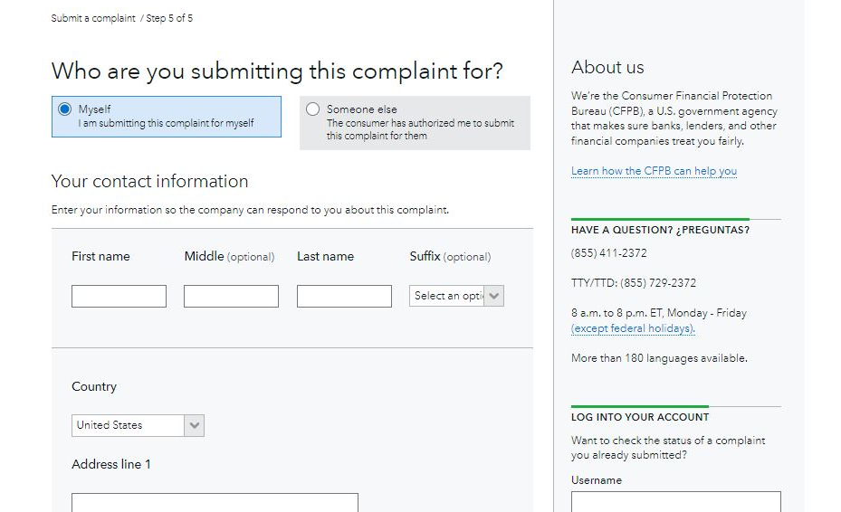
How to Submit a Complaint – Step 5 (cont’d)

Slide 50
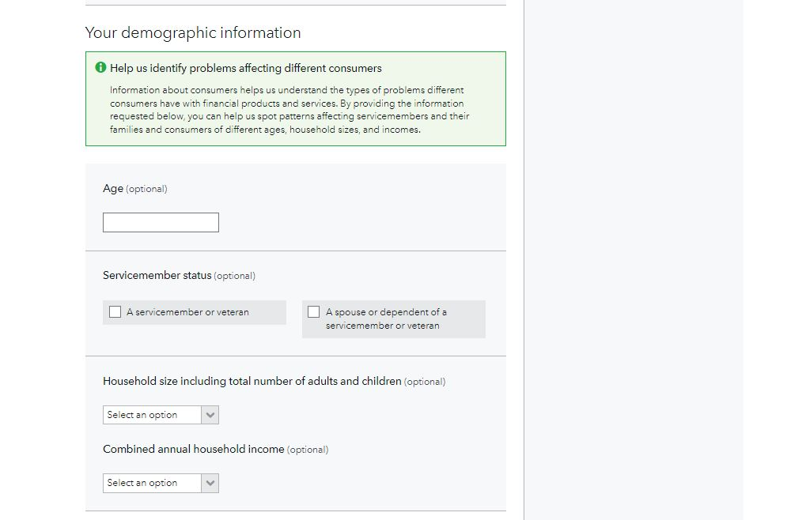
How to Submit a Complaint – Step 5 (cont’d)

Slide 51
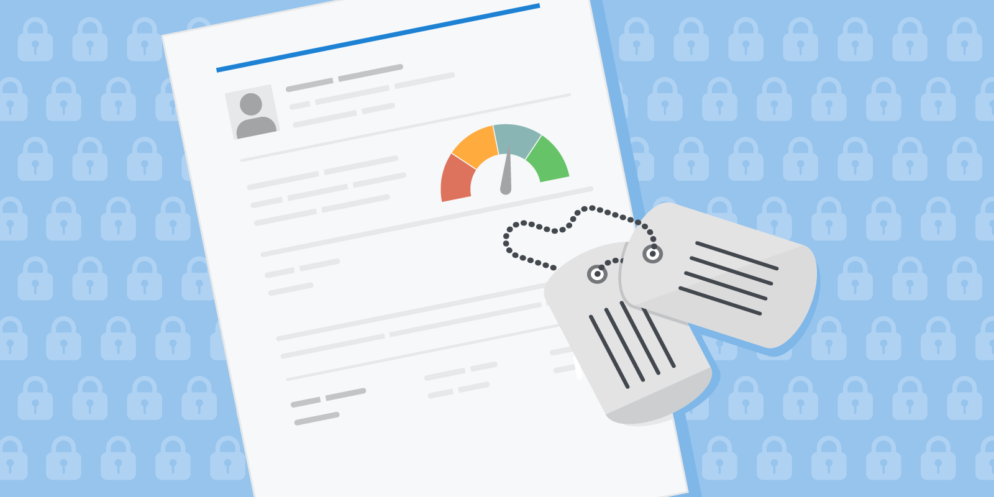
Questions?
Nelson Akeredolu
Office of Servicemember Affairs
military@cfpb.gov
consumerfinance.gov/servicemembers
Notes:
Please feel free to reach out to the Office of Servicemember Affairs if you have any questions about what we do, resources we have for the military community, or how we’re working to support Servicemembers, veterans and military families.

